Slide 1

Spam Detection & Algorithm Preference Model using Machine Learning
Project Presentation Seminar
Session 2021-22 (EVEN)
Ayushi Umredkar
Dewal Atkare
Sakshi Mandurkar
Shashank Pawsekar
Shweta Tayde Guide
Prof. Alok Chauhan
Department of Information Technology
Rajiv Gandhi College of Engineering & Research,
Nagpur- 441 110 (MS)

Slide 2
Outlines
Problem Definition
Objective & Scope
Process
Model
Results
Web Site Development
Plan of Action
Software & Hardware Requirement (Quotations )
References

Slide 3
Problem Definition
In recent times, unwanted commercial bulk emails called spam has become a huge problem on the internet.
The person sending the spam messages is referred to as the spammer. Such a person gathers email addresses from different websites, chatrooms, and viruses. Spam prevents the user from making full and good use of time, storage capacity and network bandwidth.
The huge volume of spam mails flowing through the computer networks have destructive effects on the memory space of email servers, communication bandwidth, CPU power and user time.
Users who receive spam emails that they did not request find it very irritating. It is also resulted to untold financial loss to many users who have fallen victim of internet scams.

Slide 4
Objective
We present a systematic review of some of the popular machine learning based email spam filtering approaches. Our review covers survey of the important concepts, attempts, efficiency, and the research trend in spam filtering.
Our Project Focus on to perform an Email or SMS Spam Detection in the form of Web App.
We Have Customized our Algorithm Preference Model that performs the analysis and gives the top performing algorithm on the database by calculating the precision and accuracy with respect to time.

Slide 5
Process
Our Process starts with The Database according to aur classification. We required a decent amount of database which will be enough to retrieve the word count of the spam and not spam messages.
The database we have is in the raw format, So We are Performing the following actions
Data cleaning
Exploratory data analysis
Text Pre-processing

Slide 6
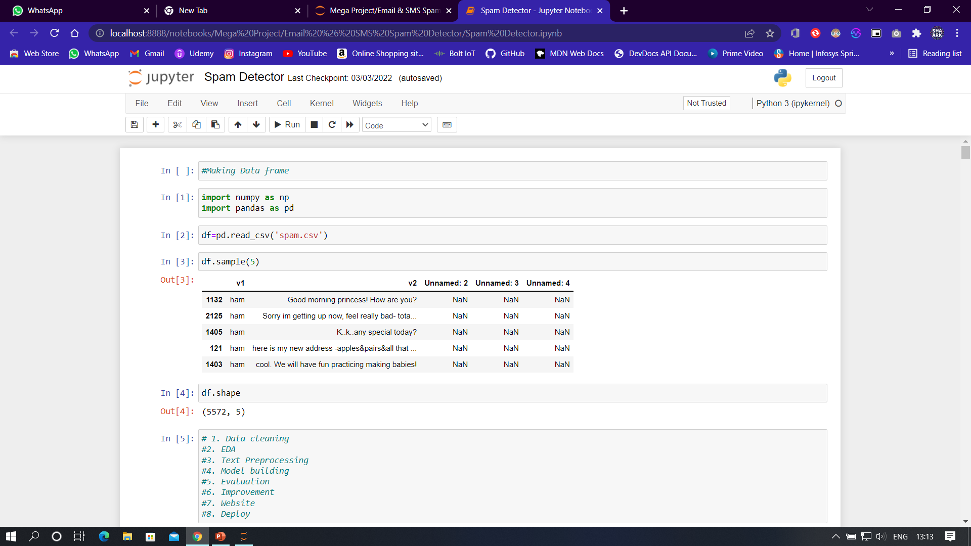
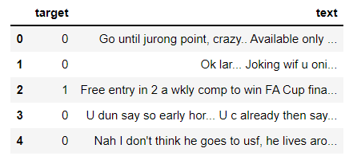
Process
Data cleaning
Remove unwanted columns.
Renaming data columns in meaningful way.
Convert the data belonging to target in numeric format.
Remove missing values and duplicate values.
Before
After

Slide 7
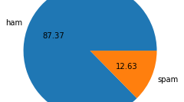
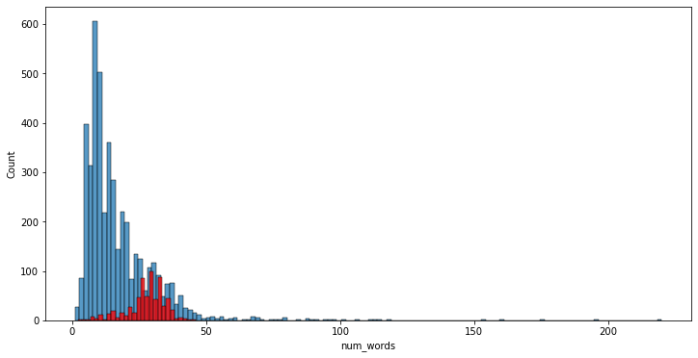
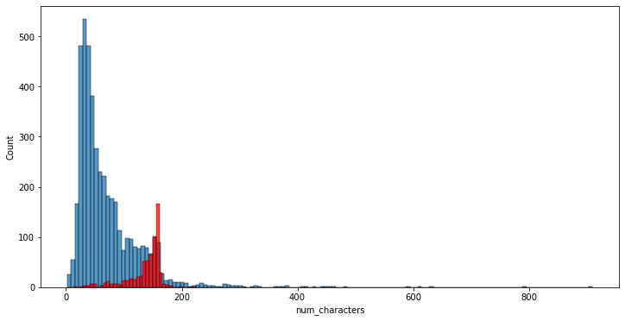
Process
2. EDA
Checking the percentage of the ratio of spam and not spam emails or SMS.
According to our data frame the data is imbalanced, so the further process will be will vary according that perspective.
Now we're counting the number of words ,characters And sentences and adding respective columns in our data frame .
Describing feature columns Calculating it's mean and overall count .
Making pear plots according to data.

Slide 8
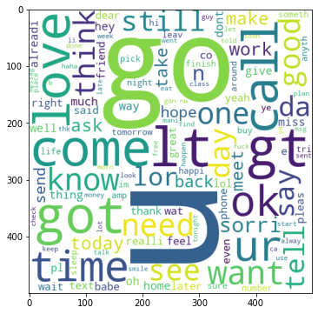
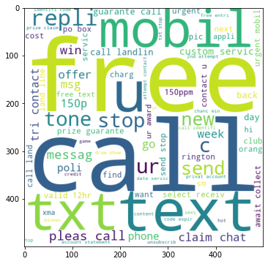
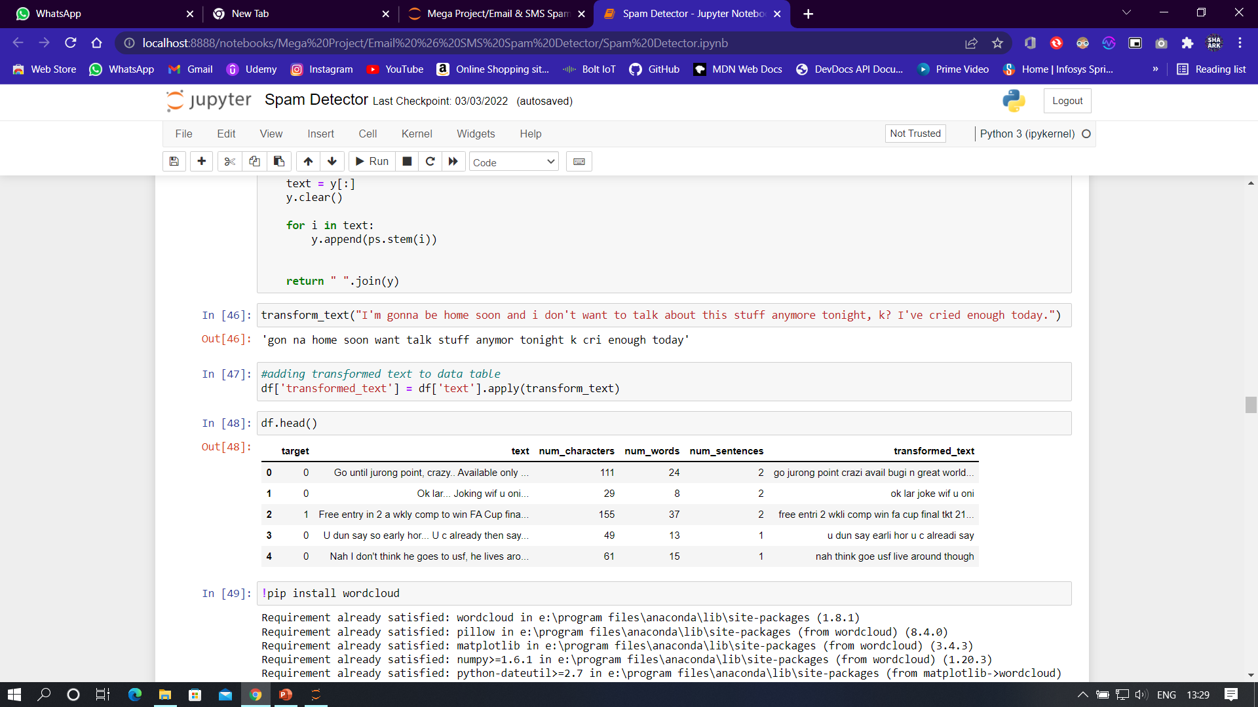
Process
3. Text Preprocessing
Converting data that is messages with respect to our need as follows
lower case Conversion
Tokenization
removing special characters
removing stop words and punctuation
stemming of the woods
Display of World cloud After conversion of the text
Analysing top words according to spam and not spam.
Not Spam
Spam

Slide 9
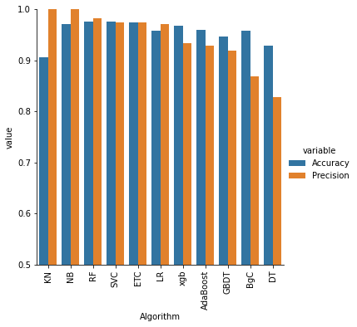
_{Model}
4. Model building
By our previous research conclusion, the naïve bayes algorithm is most Frequent used Classification algorithm ,so we are Performing the most used naïve bayes algorithms.
naïve bayes algorithm requires numeric input ,So we are using TFIDF to convert or vectorize the text.
There are multiple algorithms we can use for our classification That can help us in different textual input so that the accuracy and precision of the model determine automatically. Hence, we customized our model with the help of new data frame that can grade the algorithm through accuracy and precision with respect to time.
By this feature we always have a preference of the algorithm according to our data .

Slide 10
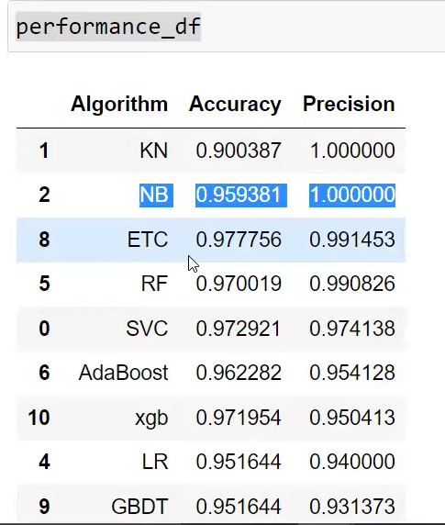
Results
5. Evaluation
Now we get our results according to the all algorithms and the top performing are naïve bayes , Kneighbors , Random forest & ExtraTrees .
According time & performance required we choose naïve bayes Algorithm.

Slide 11
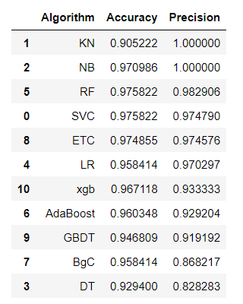
Results
6. Improvement
In TF IDF vectorization there is a feature limitation named as Max features which limits the count of word, ie. All Frequent words will be compared with the range of 3000.
Using the voting classifier And stacking with the combination of good performing algorithms with low accuracy

Slide 12
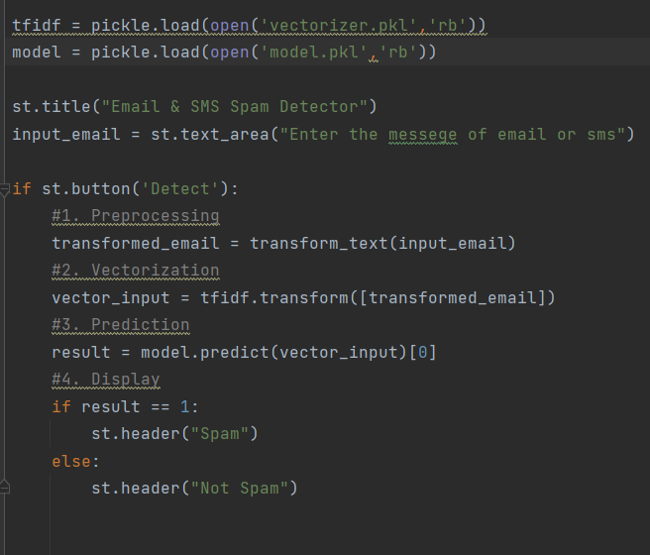
Web Site Development
7. Website
For website architecture we are using streamlit library.
Using Pycharm Software for web app deployment
Importing all the libraries and functions we are created in our model.
For site structure we are making a heading, text area for writing email or SMS and button called as detect. After clicking button, it gives the result As spam or not spam.
8. Deploy
Streamlit run webapp.py for launch local host.
Also, for web deployment we are using heroku server.

Slide 13
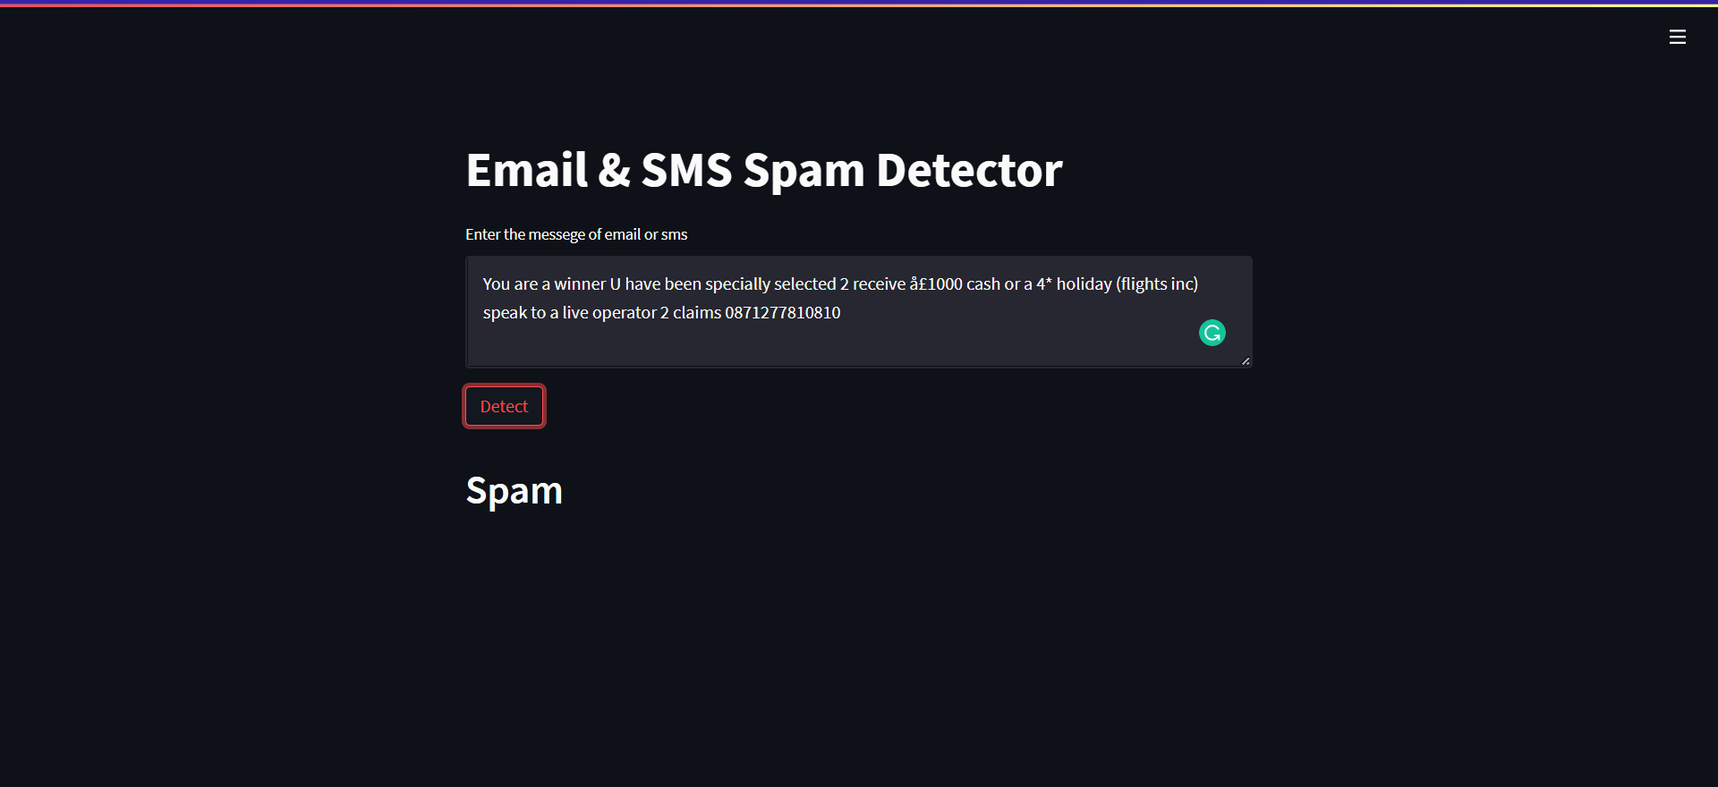
Tentative Website Design

Slide 14
Software & Hardware Requirements
Software-
LANGUAGE : Python, Bash,
Libraries : nltk, sklearn, streamlit.
DATABASE : .csv (Exel)
HOSTING PLATFORM : Heroku
SOFTWARE : Jupyter Notebook, Pycharm
Hardware-
PC / Laptop
Server if Available

Slide 15
Plan of Action
No. | Duration of Week | Work Done by projectees
1 | 22-29/09/2021 | Topic Discussion
2 | 30-06/10/2021 | Research Spam
3 | 07-20/10/2021 | Process and Methods
4 | 22-27/10/2021 | Literature Survey - 1
5 | 28-10/11/2021 | Literature Survey - 2
6 | 11-24/11/2021 | Paperwork
7 | 20/12-02/01/2022 | Model Framing
8 | 03- 16/01/2022 | Data Cleaning & EDA
9 | 17- 28/01/2022 | Text Preprocessing
10 | 01-24/02/2022 | Model building & Algorithm Prfr.
11 | 24/02- 04/03/2022 | Site Development & Hosting

Slide 16
References (Journal Papers , Website, Book)
Phishing Email Detection Using Natural Language Processing Techniques: A Literature Survey ScienceDirect papers
A Comprehensive Review on Email Spam Classification using Machine Learning Algorithms ieee papers
Machine learning for email spam filtering -sciencedirect
A survey on opinion spam detection methods -researchonline

Slide 17
Thank You

